Slide 1
无人机集群路径规划 Path planning of UAV cluster
专业阅读与写作（研讨）
71121139 孔晔
09021232 薛沛林
09021230 孙彦林
71121140 杨政贤

Slide 2
方向介绍
集群:
集群指能够与其他个体以及周围环境交互作用的若干个体集合
集群并不是对多个个体进行简单的连接和组合,而是使众多个体高效协作、紧密耦合
集群技术将大大提高个体行为的智能化程度，更好地完成单个个体无法完成的工作

Slide 3
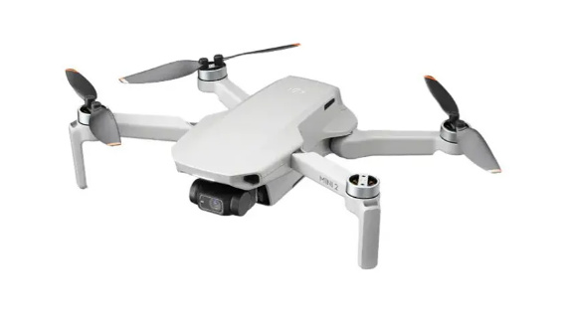
方向介绍
无人系统指平台:
无人系统是由机械、控制、计算机、通信、材料以及人工智能等多种技术融合而成的复杂系统
两个显著特点：无人化和智能化

Slide 4
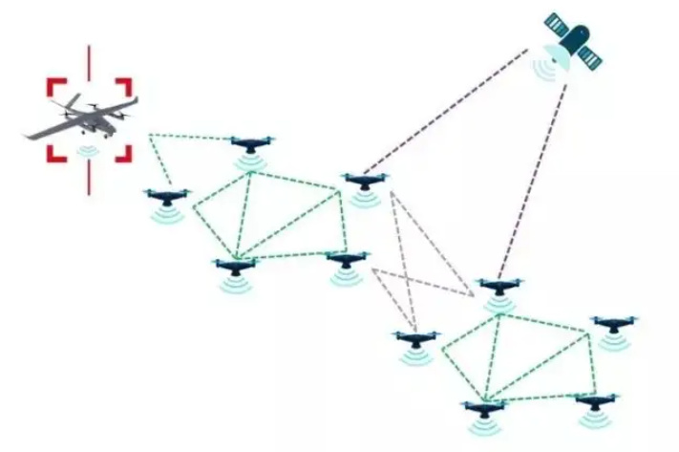
方向介绍
智能无人机集群:
智能无人机集群是指由一定数量的无人机、控制系统及人机界面组成，利用信息交互与反馈、激励与响应，实现相互间行为协同,适应动态环境，共同完成特定任务的智能联合系统
集群
无人系统平台
智能无人机集群

Slide 5
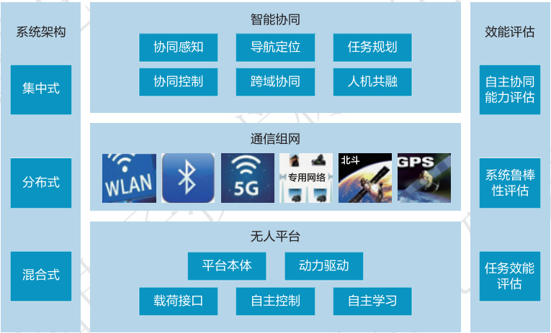
智能无人集群系统技术体系
智能无人集群系统技术体系包括:系统架构、无人平台、通信组网、智能协同和效能评估等五个方面
Notes:
A theoretical paper describes a theory or algorithm or provides a mathematical proof for some hypothesis.
A system paper describes an implementation of an algorithm, or part or all of a computer system or application. Engineering papers are now frequently required to include descriptions of system evaluation.
A survey paper is a service to the scientific community. You are doing their research for them. Instead of reading 20+ papers to understand what a scientific topic is about, they just need to read your paper

Slide 6
Access Types
Open access journals
Subscription journals

Slide 7







Types of Publication
Timely
Technical
Reports
Conference
Papers
Journal
Papers
Book
Chapters
Trust
CCF Ranking

Slide 8
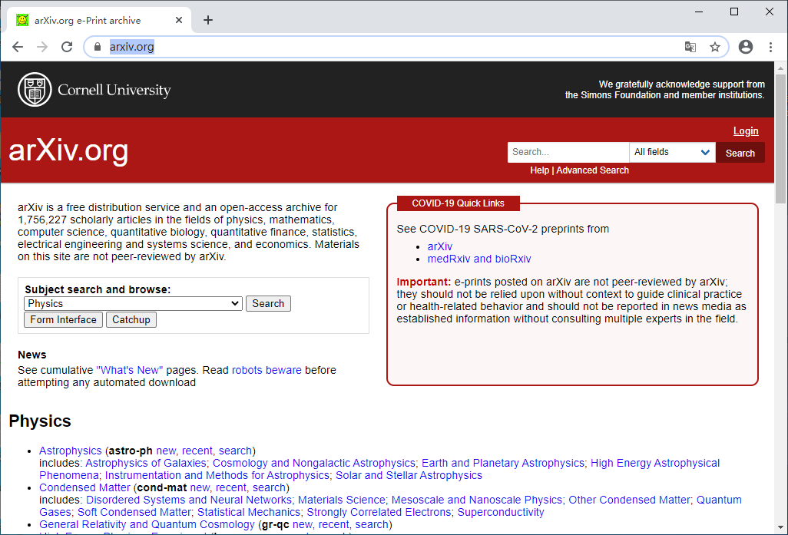
arXiv
https://arxiv.org/

Slide 9
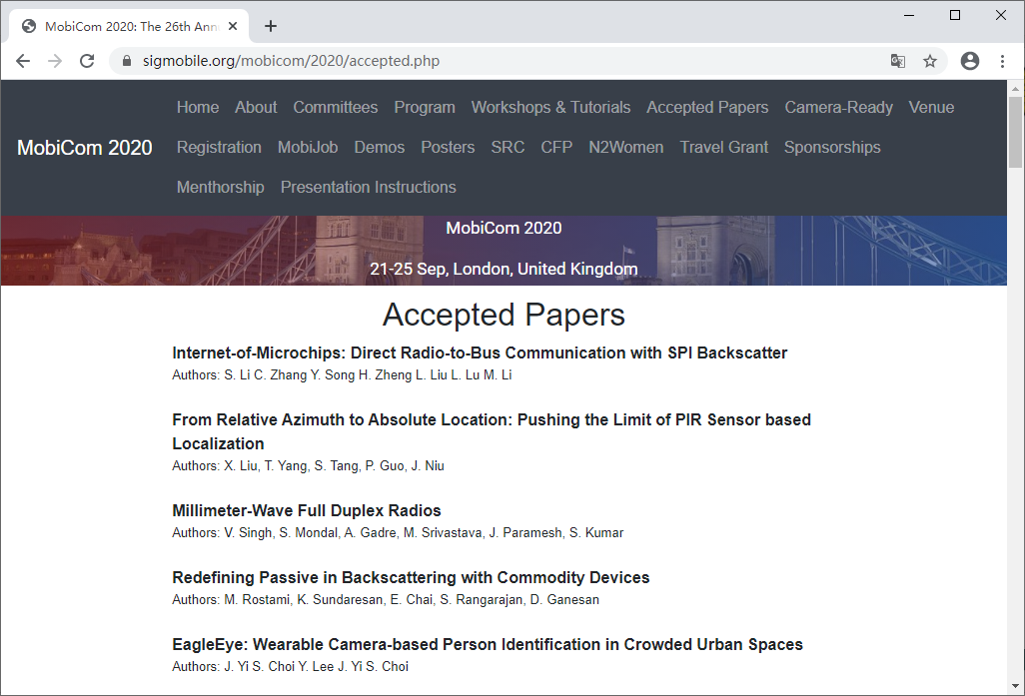
Academic Conference
International Conference on Mobile Computing and Networking

Slide 10
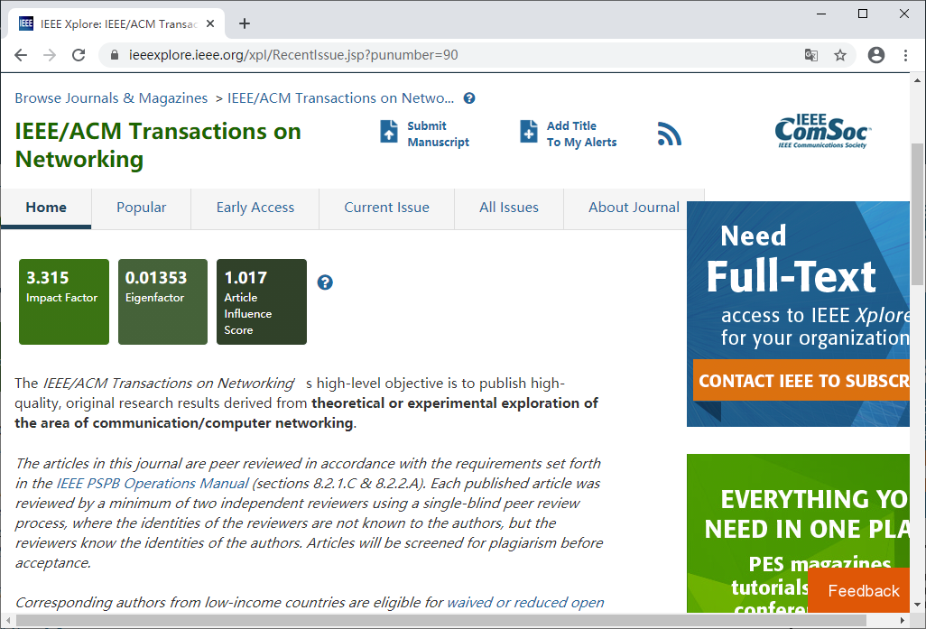
Academic Journal
IEEE/ACM Transactions on Networking

Slide 11

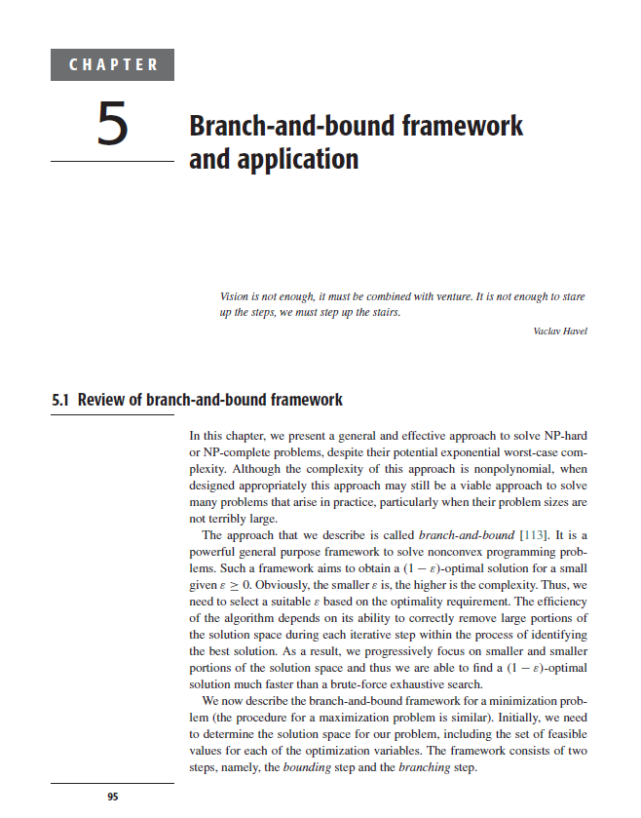
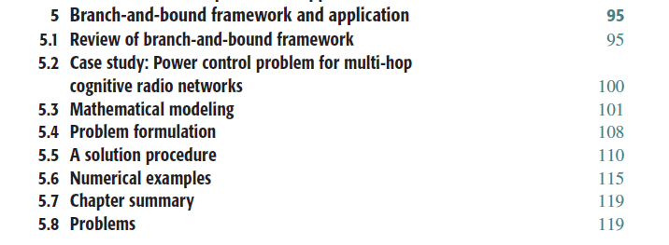
Book Chapter
2013年出版
Y. Shi, Y.T. Hou, and H. Zhou, “Per-node based optimal power control for multi-hop cognitive radio networks,” IEEE Transactions on Wireless Communications, vol. 8, no. 10, pp. 5290–5299, October 2009.

Slide 12
SCI & EI
Science Citation Index, SCI
Web of Science
https://webofknowledge.com
Impact Factor, JCR
Engineering Index
Engineering Village
https://www.engineeringvillage.com
Notes:
汤森路透知识产权与科技业务，2016年被卖了，Clarivate Analytics

Slide 13
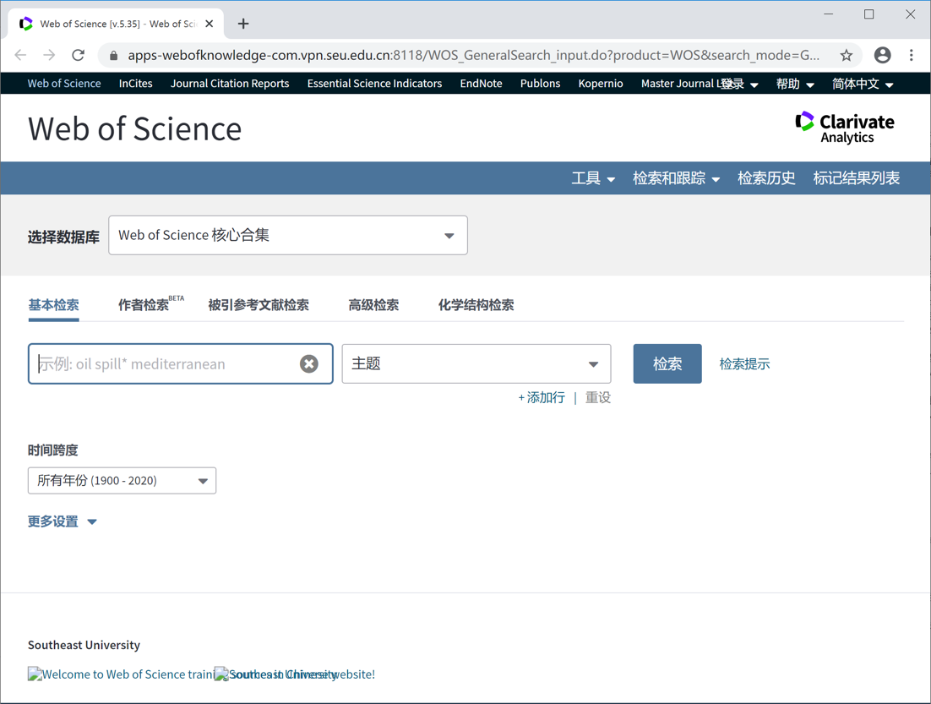
Web of Science

Slide 14
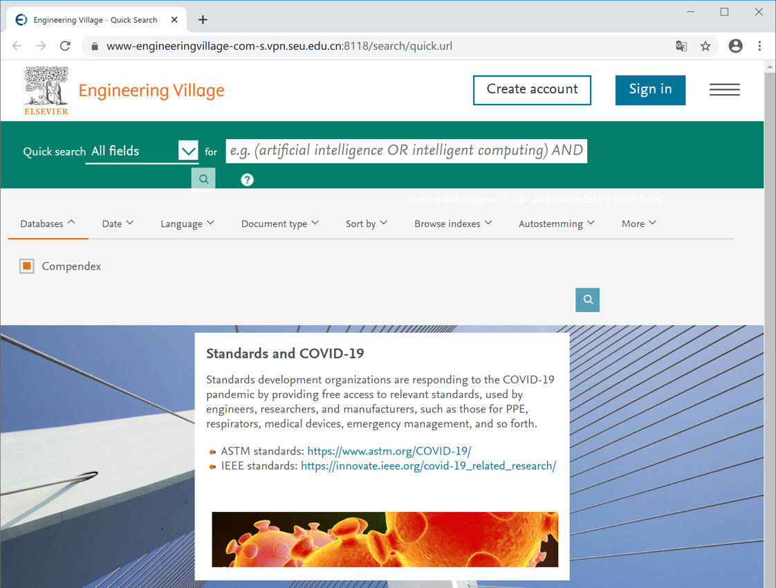
Engineering Village
Notes:
欧元

Slide 15

什么是CCF推荐排名
中国计算机学会（CCF）推荐国际学术会议和期刊目录
共分为十个领域，每个领域又分为的国际学术会议及期刊两个目录
供国内高校和科研单位作为学术评价的参考依据

Slide 16

CCF推荐排名的历史
2010年以前，中国科研评判只有SCI一种指标
众多学者呼吁重视顶级国际学术会议上发表论文，这是计算机专业的特点
版本历史
2010年8月第一版
2011年8月第二版
2013年1月第三版
2015年12月第四版
2019年4月第五版

Slide 17

中国计算机学会推荐分档
刊物和会议分为A、B、C三档
A类指国际上极少数的顶级刊物和会议，鼓励我国学者去突破；
B类指国际上著名和非常重要的会议、刊物，有重要的学术影响，鼓励国内同行投稿；
C类指国际学术界所认可的重要会议和刊物。
来源：中国计算机学会推荐国际学术会议和期刊目录第1-3版

Slide 18
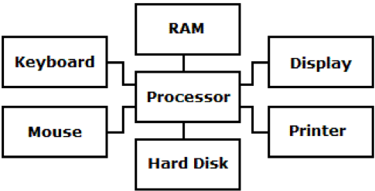

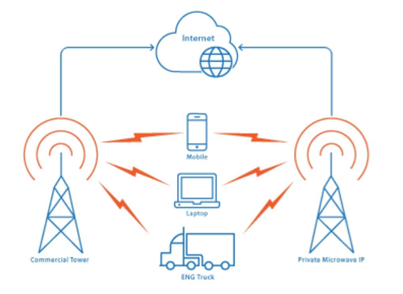
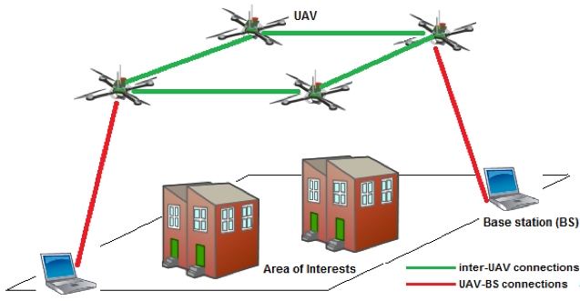
CCF推荐列表 https://www.ccf.org.cn/Academic_Evaluation/By_category
1）计算机体系结构／高性能计算／存储系统；
2）计算机网络；
Notes:
每个用一两句话概况一下

Slide 19


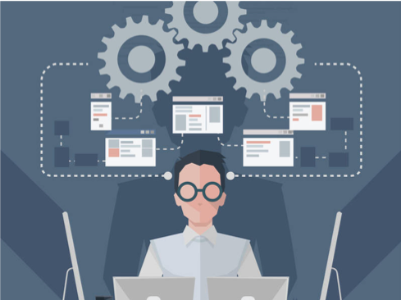
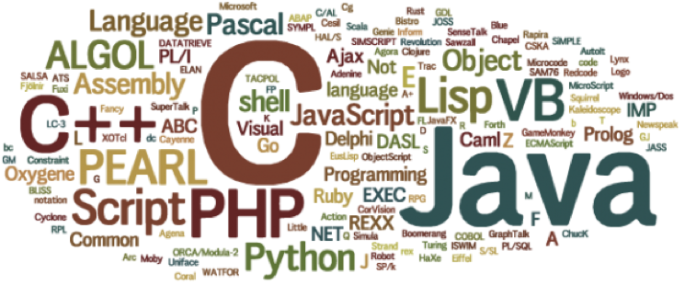
CCF推荐列表 https://www.ccf.org.cn/Academic_Evaluation/By_category
3）网络与信息安全；
4）软件工程/系统软件/程序设计语言；

Slide 20
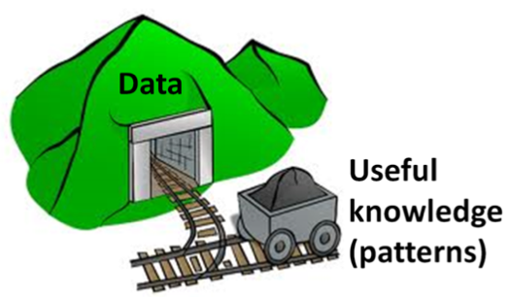

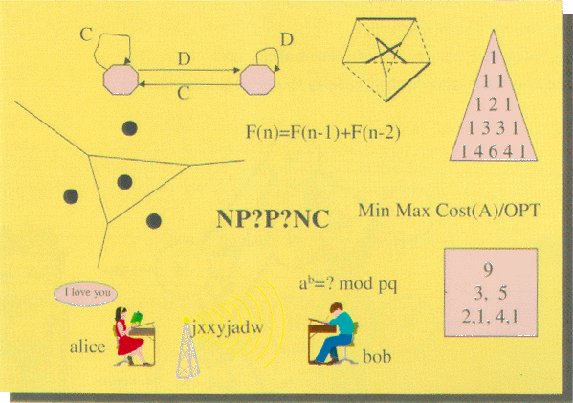
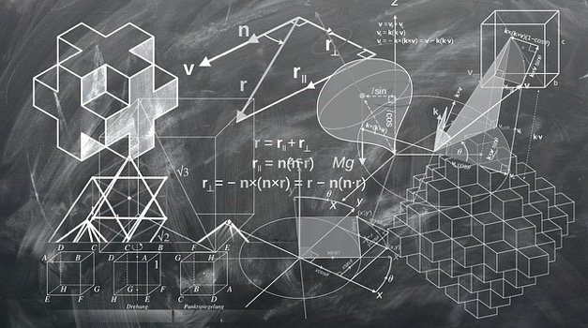
CCF推荐列表 https://www.ccf.org.cn/Academic_Evaluation/By_category
5）数据库/数据挖掘/内容检索；
6）计算机科学理论；

Slide 21
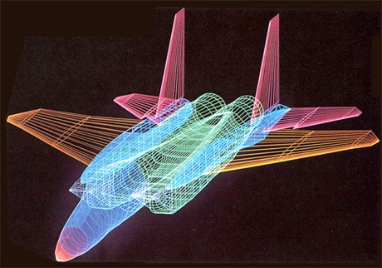


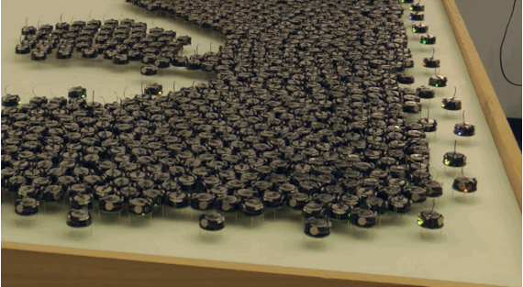
CCF推荐列表 https://www.ccf.org.cn/Academic_Evaluation/By_category
7）计算机图形学与多媒体；
8）人工智能；

Slide 22


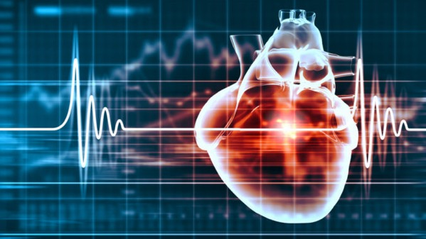
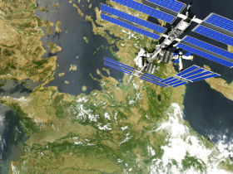
CCF推荐列表 https://www.ccf.org.cn/Academic_Evaluation/By_category
9）人机交互与普适计算；
10）交叉/新兴／综合等

Slide 23
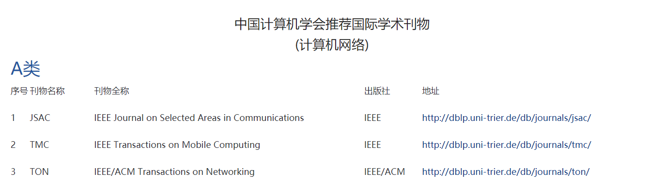
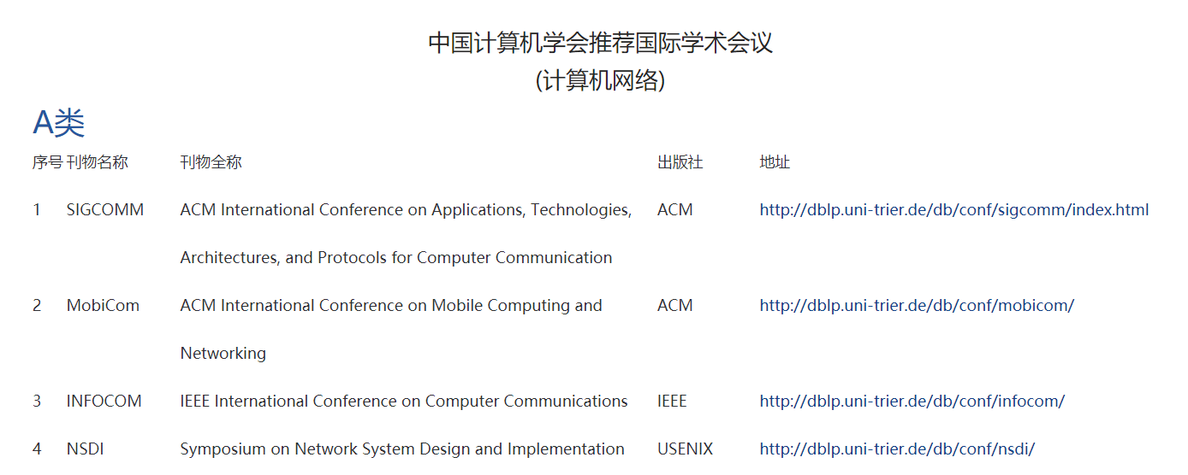
计算机网络

Slide 24
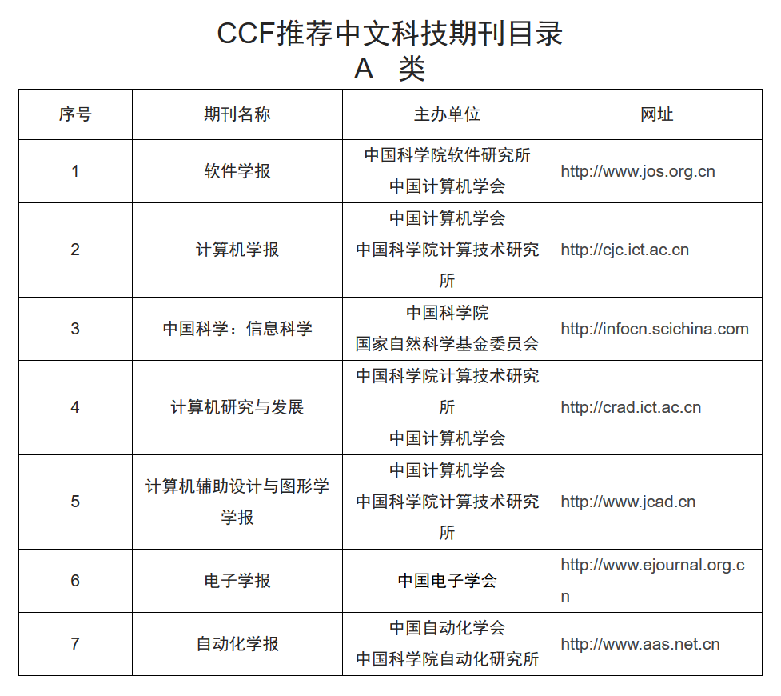
CCF中文目录 - 把论文写在祖国的大地上
Notes:
总书记说得好：“广大科技工作者要把论文写在祖国的大地上，把科技成果应用在实现现代化的伟大事业中。”

Slide 25
学术搜索入门

Slide 26
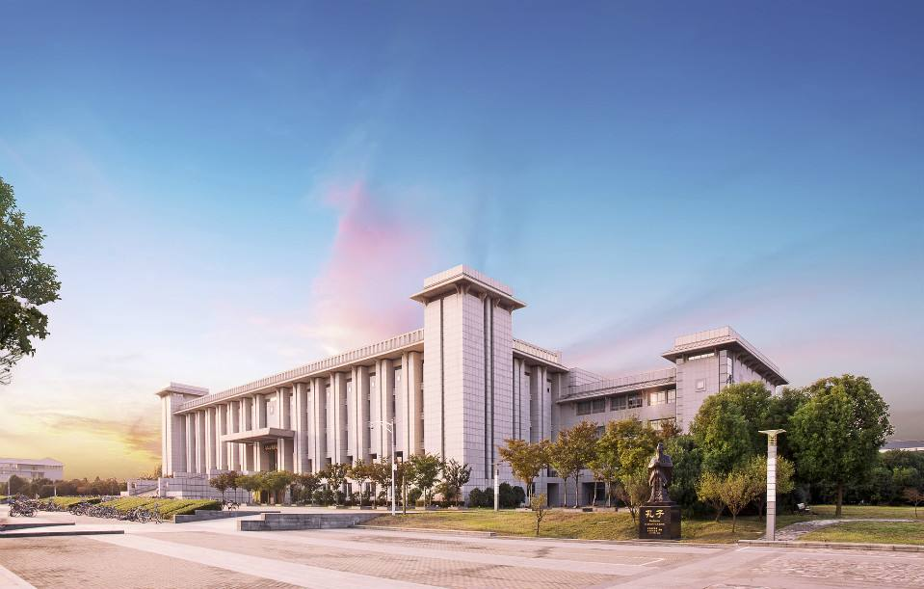
收费学术论文数据库
大部分学术数据库都要收费！而且很贵！
学校图书馆已经为我们准备了丰富的学术数据库(比大多数学校都多，而且全)。
http://lib.seu.edu.cn

Slide 27
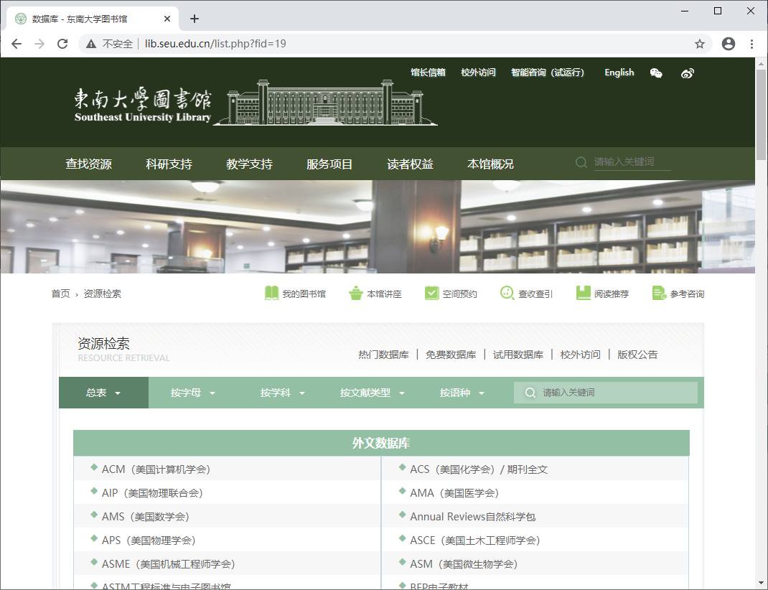
东南大学图书馆论文数据库

Slide 28
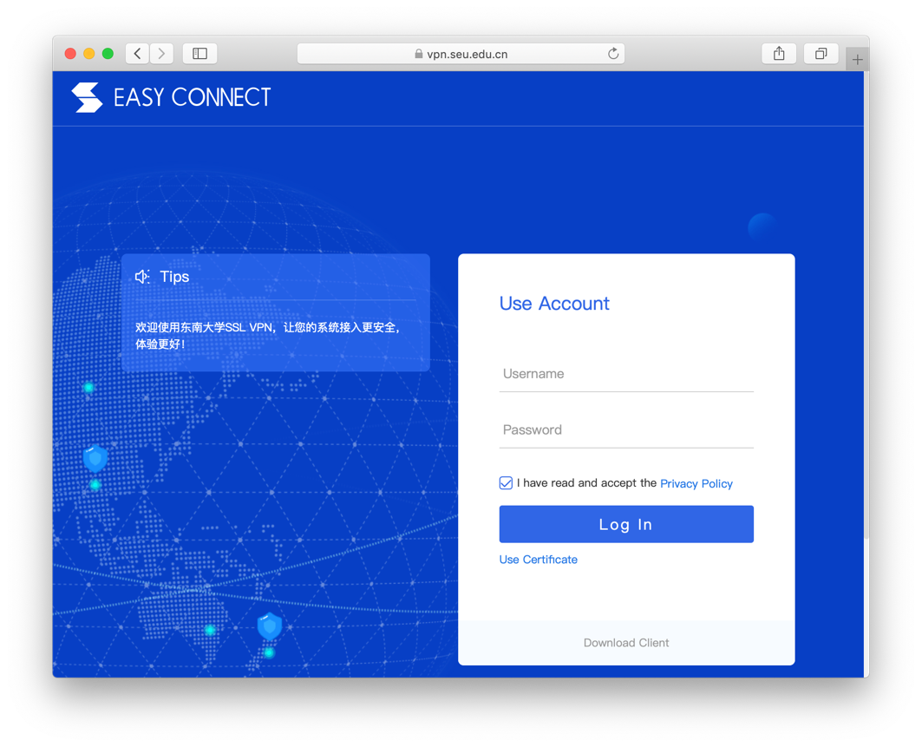
收费学术论文数据库
图书馆购买的数据库是IP认证或者镜像；
不在学校时，访问需要用到VPN
vpn.seu.edu.cn

Slide 29
ACM Digital Library
ACM, the Association for Computing Machinery, is the world's largest educational and scientific society, uniting computing educators, researchers and professionals to inspire dialogue, share resources and address the field's challenges.
The ACM Digital Library is the full-text collection of all articles published by the ACM in its articles, magazines and conference proceedings.

Slide 30
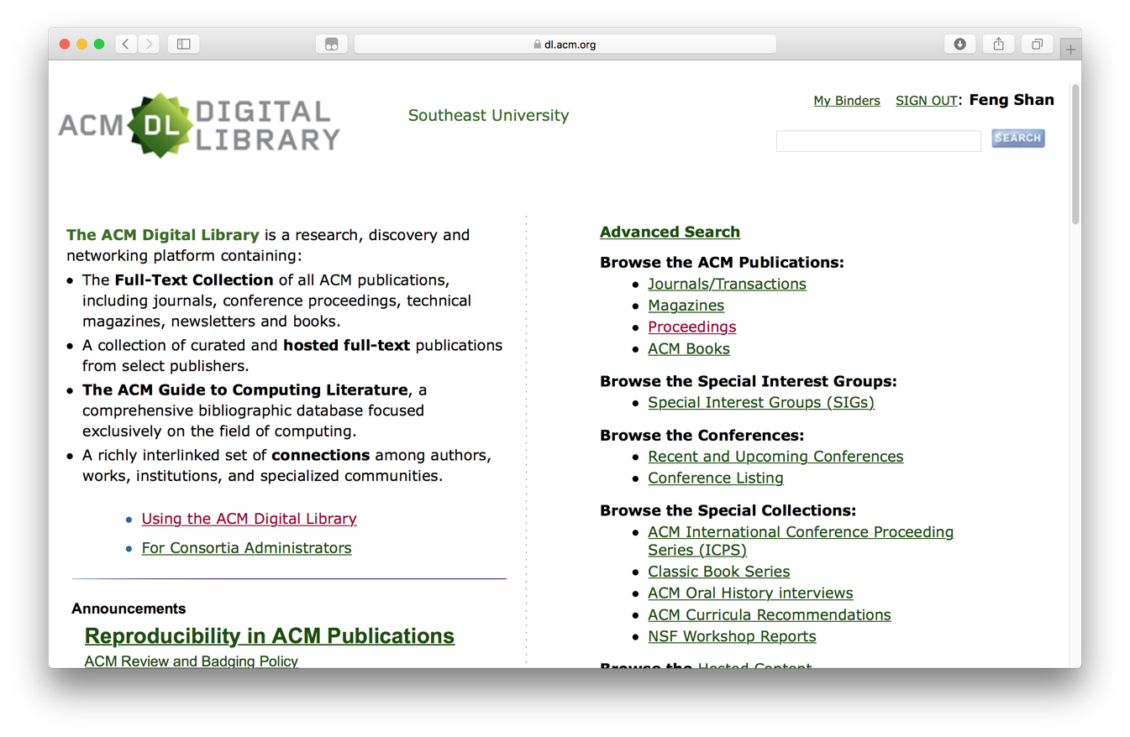
ACM Digital Library

Slide 31
IEEE Xplore Digital Library
IEEE, an association dedicated to advancing innovation and technological excellence for the benefit of humanity, is the world's largest technical professional society.
IEEE's roots go back to 1884 when electricity began to become a major influence in society.
The IEEE Xplore digital library is a powerful resource for discovery of and access to scientific and technical content published by the IEEE and its publishing partners.

Slide 32
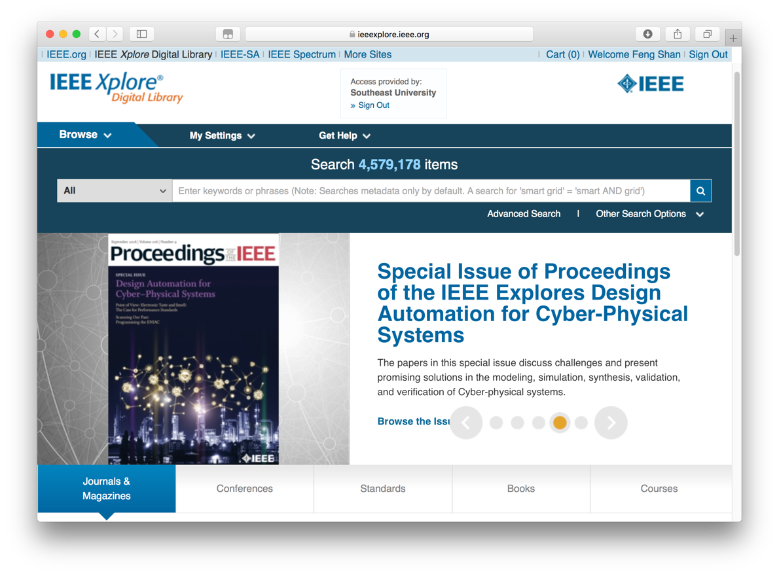
IEEE Xplore Digital Library

Slide 33
Other Digital Libraries
Springer http://www.springer.com
Our business is publishing. Throughout the world, we provide scientific and professional communities with superior specialist information.
Elsevier https://www.elsevier.com
Elsevier helps institutions and professionals progress science, advance healthcare and improve performance.
Notes:
这些都是基于出版商的搜索，
有没有更加通用的搜索？

Slide 34

Google学术检索
Google学术(http://scholar.google.com)
最强大的学术工具，没有之一。
优点
配合Google强大的搜索能力，根据相关性对搜索结果进行排序
可以跟踪作者和论文(如有论文被引用或者作者有新论文就会提醒)
支持多种格式的参考文献导出

Slide 35
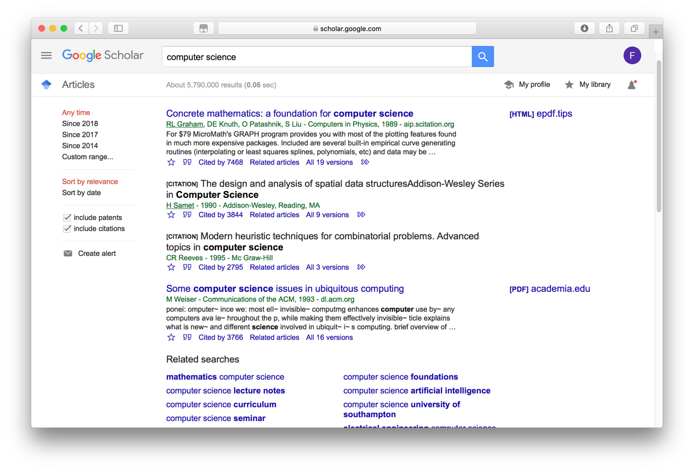
Google学术检索

Slide 36

DBLP学术检索
DBLP(http://dblp.uni-trier.de/)
以作者为核心的集成数据库
优点
提供的是书目服务，相当于一个信息媒介
以作者为中心查找文献信息
收录了arXiv(作品不会进行同步更改，一旦出版后dblp会更改它的作品类型)
文献基于科学价值，高质量元数据可用性，会议科学质量等排序
对会议检索很快，会将作者的相关工作整理归类。也会将会议的论文整理。

Slide 37
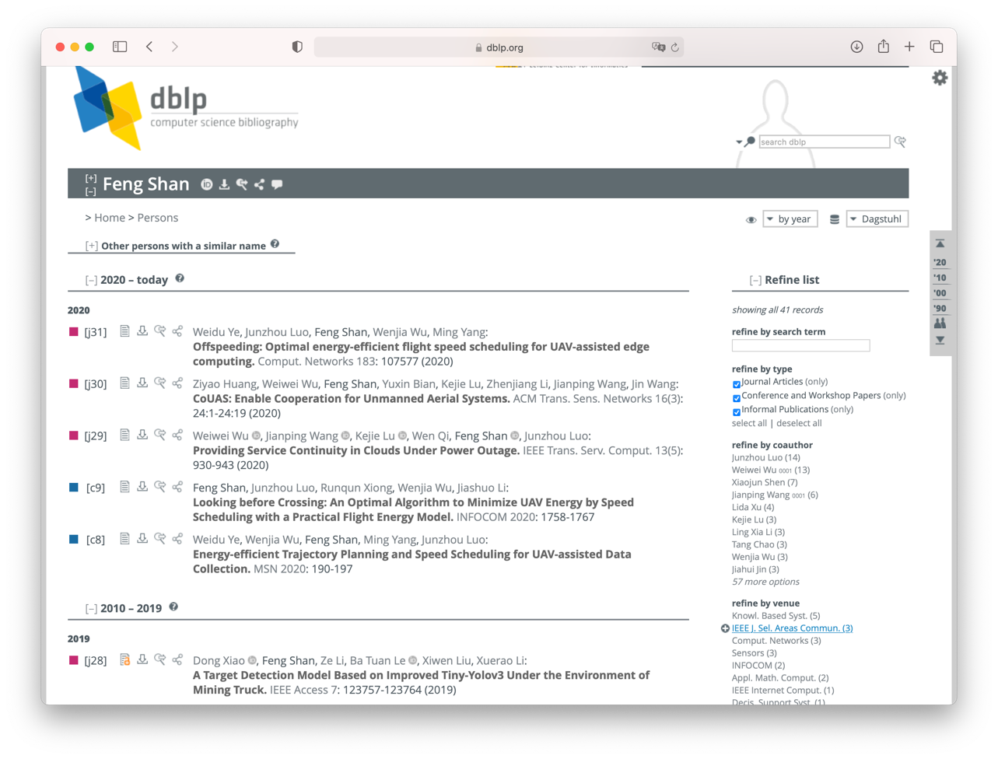
DBLP学术检索

Slide 38
Acemap学术可视化搜索引擎
学术搜索系统返回论文列表
导致学术数据散点化。
将学术论文、作者、机构等组织成网络
通过网络分析和数据挖掘，以图像形式展现
已经实现功能
动态引用网络展示，论文聚类，学术族谱，研究者画像，作者和会议主页等等。
完全由国内自主研发的新式学术搜索系统

Slide 39
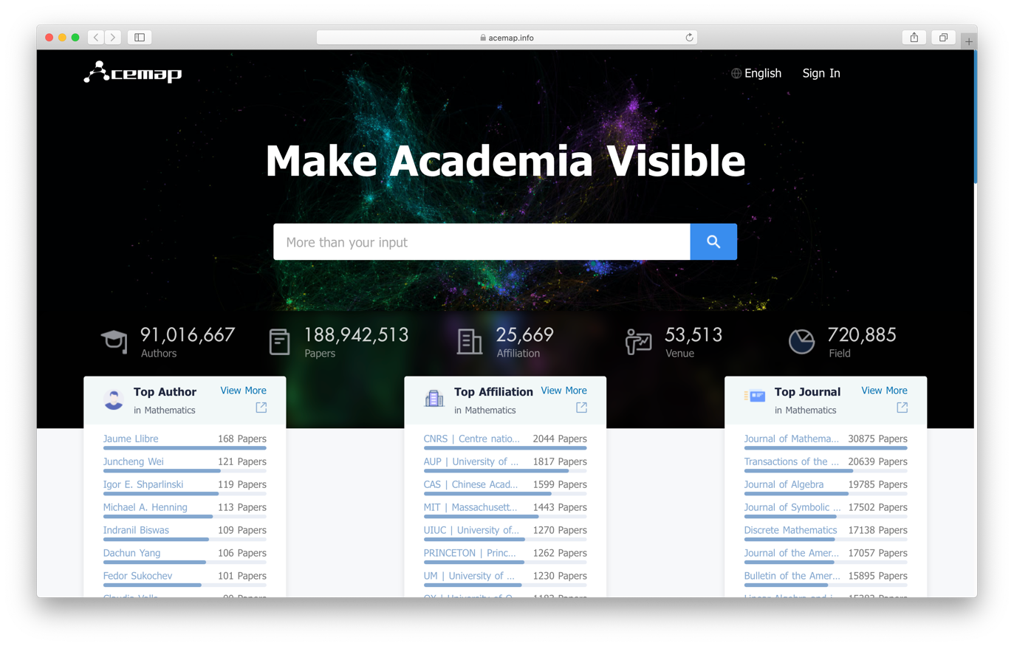
Acemap学术可视化搜索引擎

Slide 40
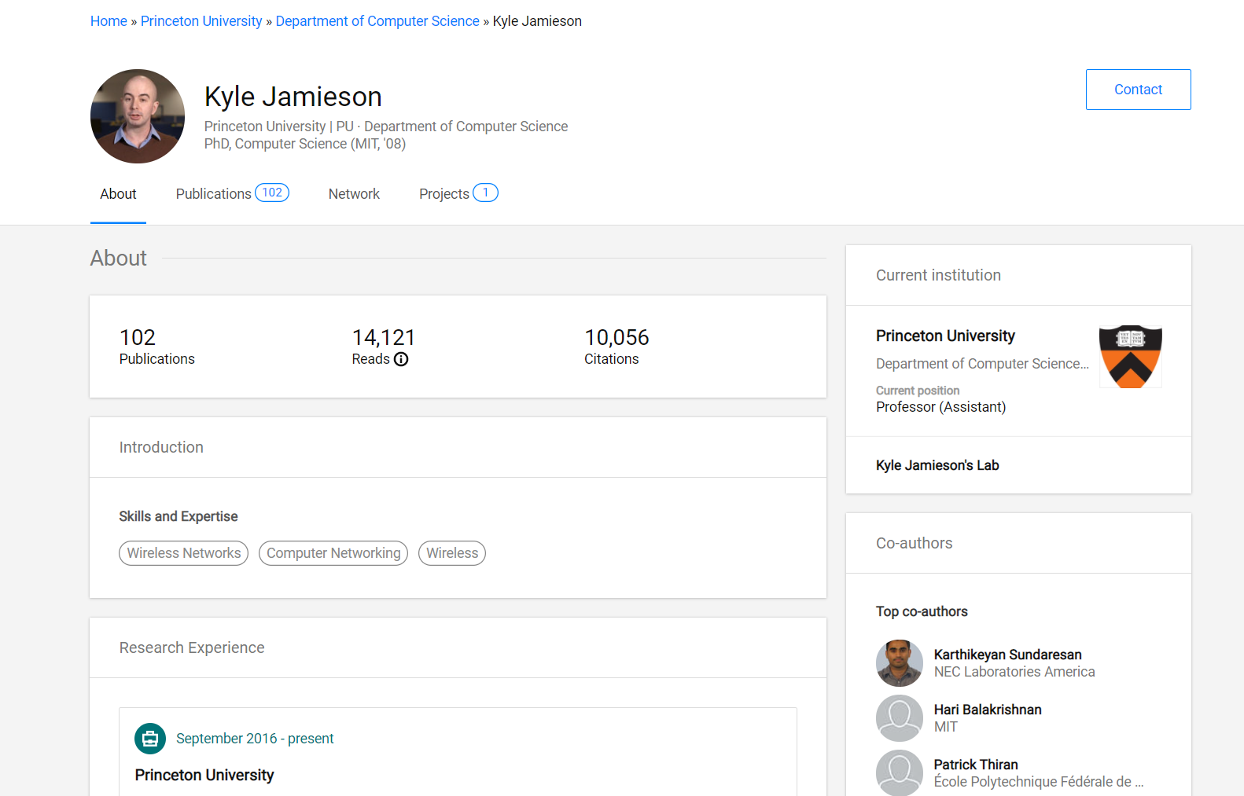
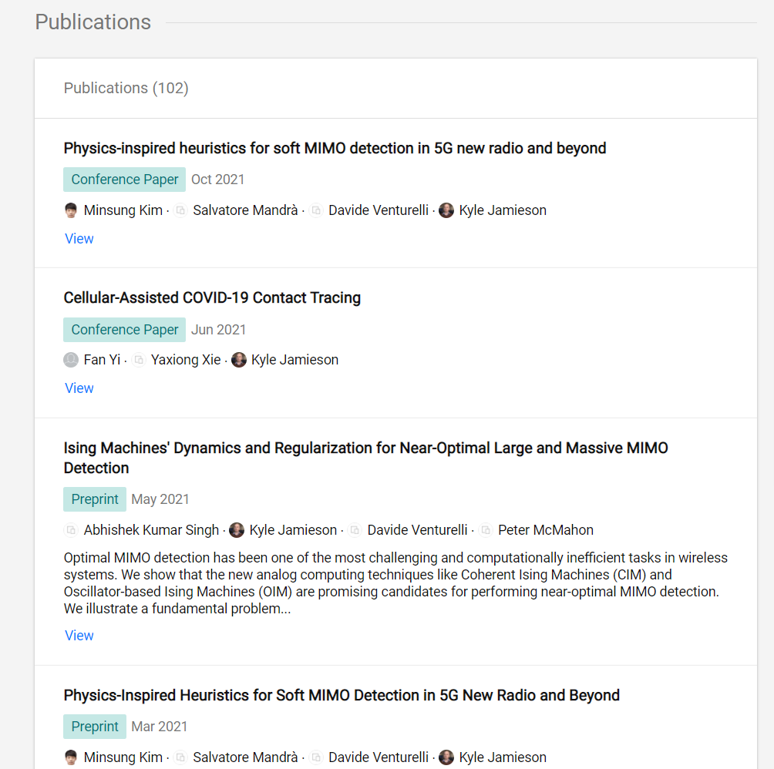
ResearchGate
ResearchGate, 全球学术圈的交流平台
分享自己出版物，学术报告，数据等；同时可以访问其他学者的研究成果
与同行的研究学者，科研合作伙伴，以及研究领域内的大牛建立联系并进行协作

Slide 41
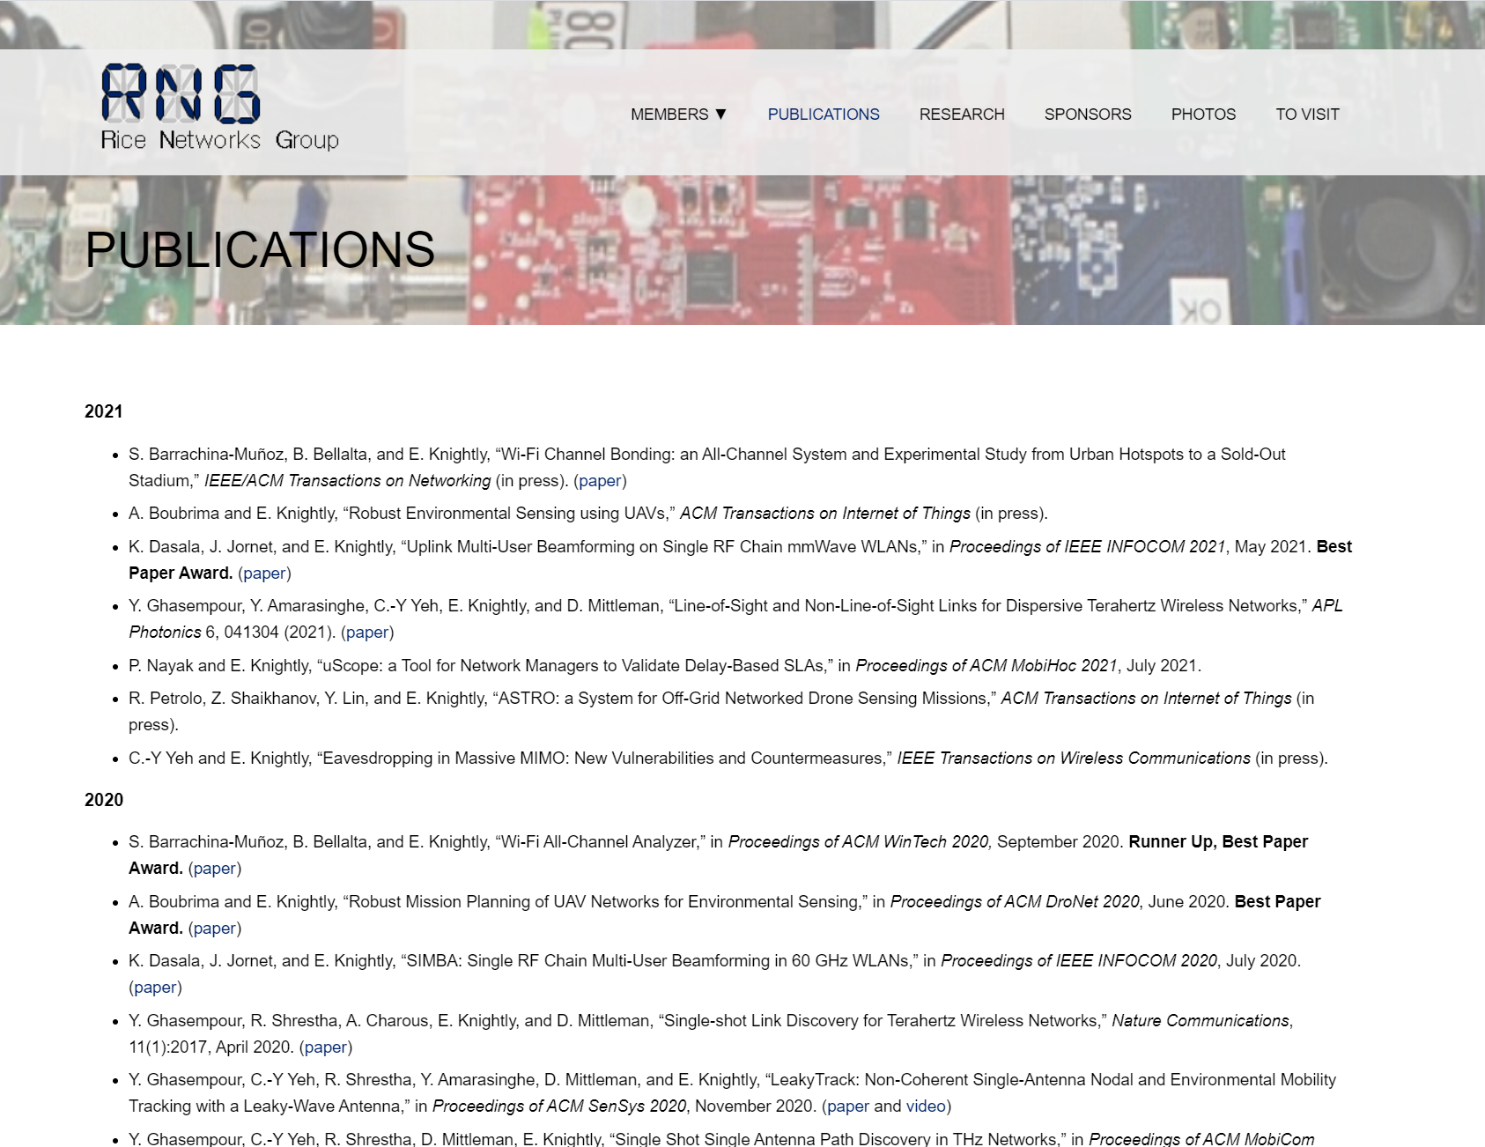
学者（实验室）主页
Edward Knightly, Rice University : http://networks.rice.edu/all-publications/

Slide 42

GitHub 开源项目
GitHub是世界顶级开发者的聚集地，分享有许多优秀、著名的开源项目，在遵守其License的前提下，可以免费使用、下载这些开源项目。

Slide 43
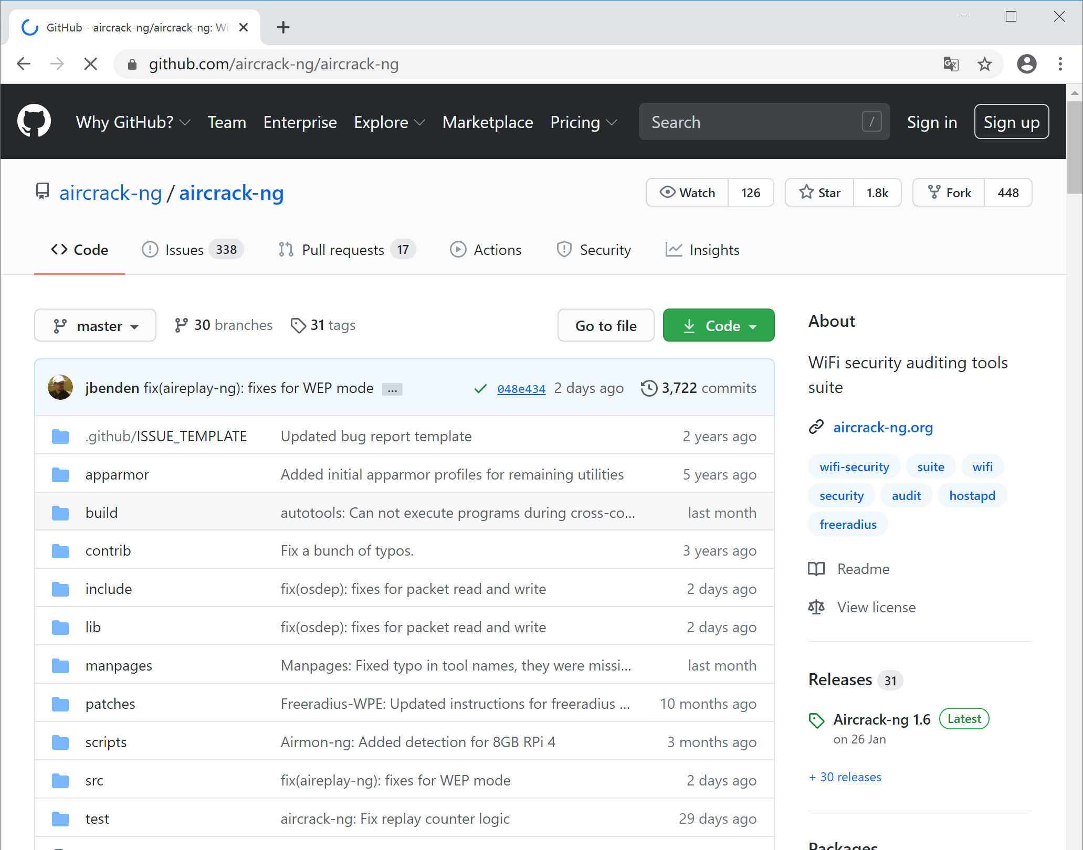
GitHub 开源项目

Slide 44
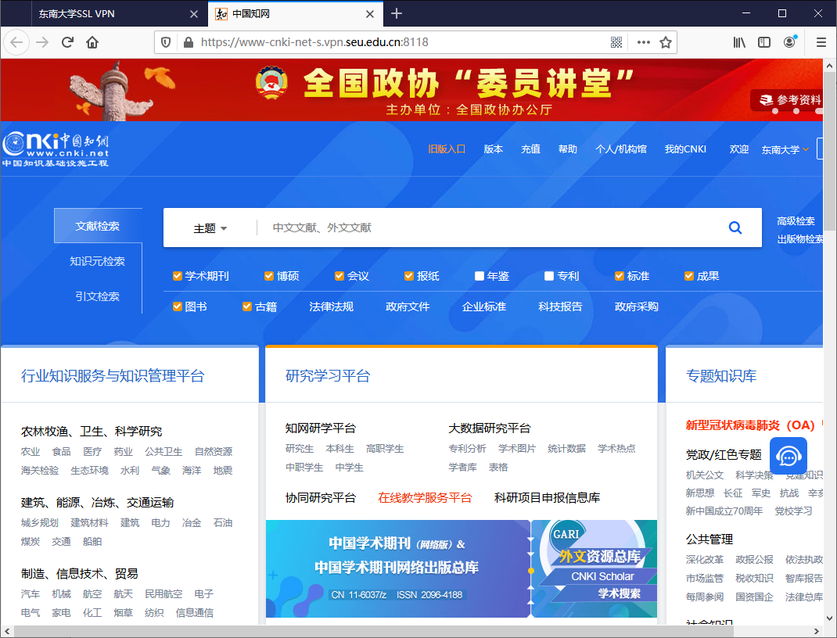
中文数据库
中国知网（CNKI，包括中国期刊网）
Notes:
欧元

Slide 45
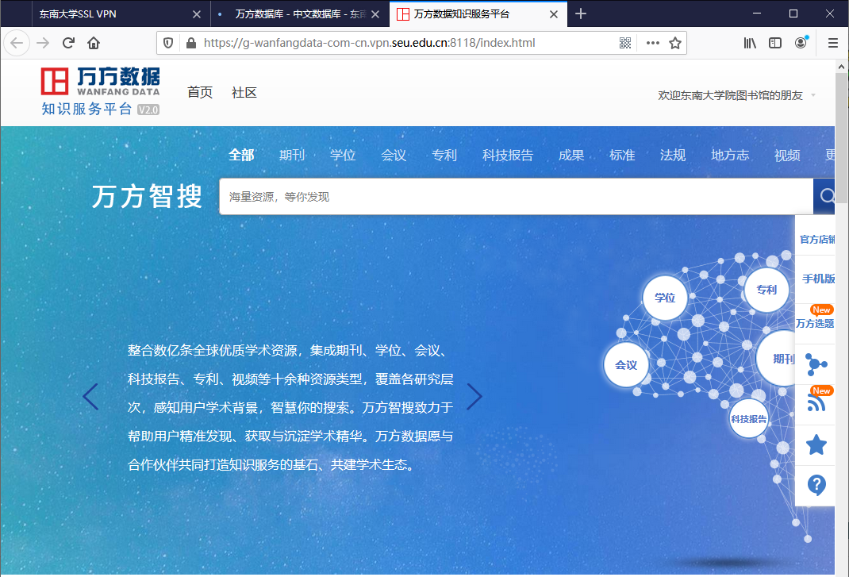
中文数据库
万方数据库
Notes:
欧元

Slide 46
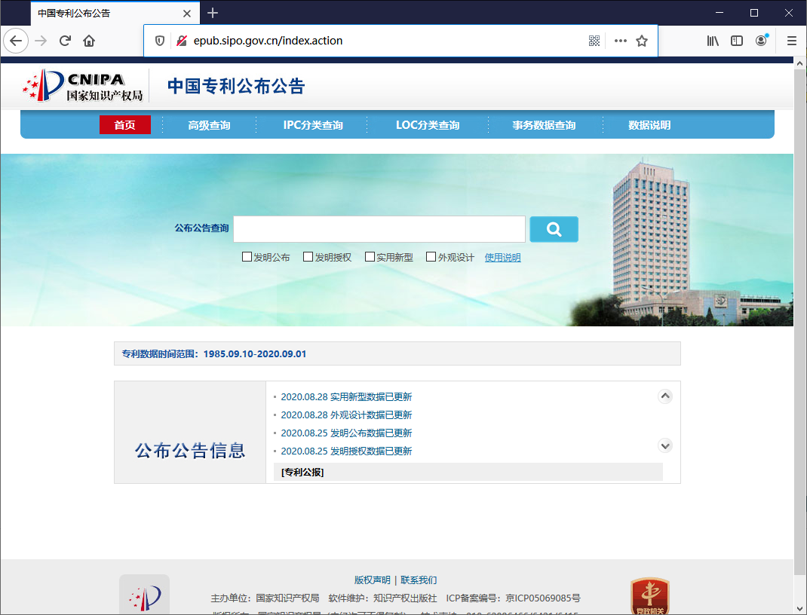
专利查询
http://epub.sipo.gov.cn/index.action

Slide 47
选择方向

Slide 48
如何选择科研方向
Google Scholar Metrics
IEEEXplore Popular Search Terms
Conference Sessions
结合自己的兴趣

Slide 49
Google Scholar Metrics
Google使用h5-index评价一个期刊的影响力
它表示5年内有h篇文章被引用超过h次

Slide 50
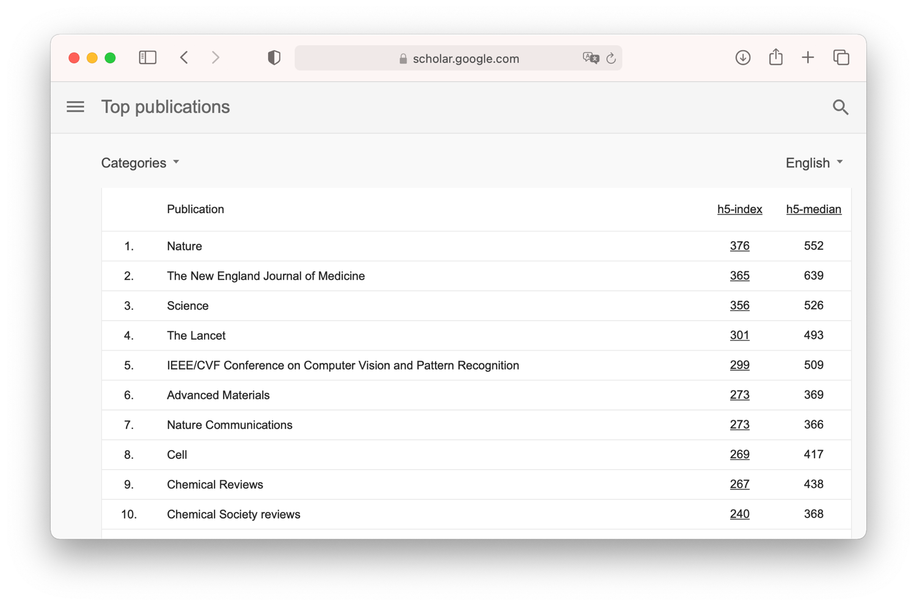
Google Scholar Metrics

Slide 51
IEEEXplore Popular Search Terms
IEEE Xplore displays
the top 10 documents downloaded for the previous month and
the top 10 search terms for the previous month.

Slide 52
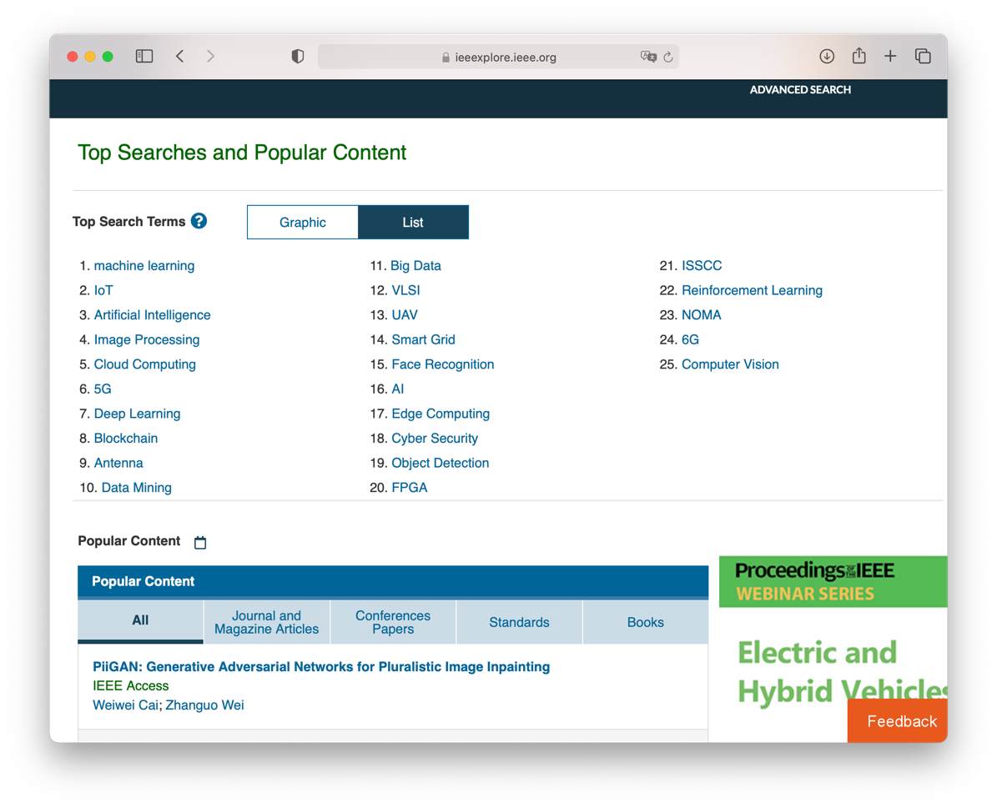
IEEEXplore Popular Search Terms

Slide 53
Conference Sessions
TUESDAY, APRIL 17, 10:30-12:00
Cloud and Edge Computing 1
Datacenter Networks
Mobile Offloading
……

Slide 54
搜索实践

Slide 55
Google Scholar
Click `Since 2018' for recent papers
papers with high citation number
authors that appear repeatedly
check their google scholar homepage and institute homepage
Click `Cited by 0xx' for papers that cites this one
click `since 20xx' for recent paper
surveys are important, `Search within citing articles' with keyword `survey’
find interesting applications by looking into a survey
refine the `Search within citing articles' with keyword `swarm’
find `Crazyswarm' paper, search Noya Ayanian, find the ACT lab

Slide 56
IEEEXplorer & DBLP
IEEEXplorer
Browse -> Journals & Magazines
search for `IEEE Journal of Selected Areas in Communications'
DBLP
at CCF ranking webpage, click the journal or conference URL, go to DBLP
find interesting keywords within these DBLP webpages
write a script to do this automatically for yourself

Slide 57
作业2
给定关键词
Wireless ad hoc
根据上述关键词，选择你认为最合适的
三篇经典的高水平英文论文
两个相关高水平国际学术会议
并给出选择的理由
参考论文格式
Feng Shan, Junzhou Luo, Weiwei Wu, and Xiaojun Shen, “Delay Minimization for Data Transmission in Wireless Power Transfer Systems,” IEEE Journal on Selected Areas in Communications (JSAC), vol. 37, no. 2 (2019): 298-312.
Feng Shan, Jiaxin Zeng, Zengbao Li, Junzhou Luo, and Weiwei Wu, “ Ultra-Wideband Swarm Ranging,” IEEE INFOCOM 2021, Virtual Conference, May 10-13, 2021.

Slide 58
作业2
整理如下内容发送给助教
按照“参考论文格式”整理三篇经典英文论文
上述选择的简要理由，以及与给定关键词的关系
两个相关高水平国际学术会议名称
上述选择的简要理由，以及查找步骤
把所有内容整理为一个PDF文件
文件名称为“学号姓名”
发给助教程玉莹（通过坚果云）
截止时间：2022年8月15日21:30

Slide 59
课程内容初步安排（以实际安排为准）
课次 | 日期 | 内容 | 作业
1 | 8月9日 | 课程简介，科研简介，生涯规划； 优秀学长学姐分享经验：大四同学、研一同学 | 海明的科研
2 | 8月11日 | 论文分类，论文评价，论文搜索； 科研报告（一）单冯 | 搜索论文
3 | 8月16日 | 论文搜索示范(作业)，如何阅读论文； 科研报告（二）王帅 | 阅读论文
4 | 8月18日 | 综述一个小领域，使用Latex； 科研报告（三）海外高校教师 | 用Latex综述自选方向
5 | 8月23日 | 如何做PPT报告（项目、论文），如何使用GIT； 科研报告（四）吴文甲 | 研究兴趣PPT 课程报告和汇报
6 | 8月25日 | 一般性课程报告写作、专业文档阅读； 科研报告（五）周强
7 | 8月30日 | 学生分组报告汇报
8 | 9月1日 | 学生分组报告汇报
Notes:
阅读的类型与技巧
1. 学术论文
2. 源代码
3. 技术手册
写作的格式与模板
1. 一般性课程报告（以算法设计与分析 课程实践 报告为例）
2. 竞赛报告（以数学建模竞赛报告为例）
3. SRTP申请和结题报告
4. 毕业设计报告

Slide 60
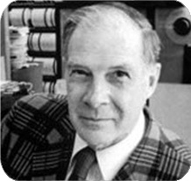
You and Your Research
http://www.cs.virginia.edu/~robins/YouAndYourResearch.html

Slide 61
You and Your Research
Luck
Courage
Age
Working conditions
Drive
Ambiguity
Emotional commitment
Work on important problems
Great thoughts
Ideas for solving problems
Open vs. closed door
Ways of doing research
Generalization and abstraction
Selling
Educating your boss
Worth being a great scientist?
Failure analysis

Slide 62
Luck
Characteristic of great scientists: “usually when they were young they had independent thoughts and had the courage to pursue them”
“Luck favors the prepared mind.” - Pasteur
“If others would think as hard as I did, then they would get similar results.” - Newton
“Is it luck that [Einstein] finally created special relativity? Early on, he had laid down some of the pieces by thinking of the fragments. Now that's the necessary but not sufficient condition. All of these items I will talk about are both luck and not luck.”

Slide 63
Courage
Characteristic of great scientists: “having courage”
“Once you get your courage up and believe that you can do important problems, then you can. If you think you can't, almost surely you are not going to.”
“They will go forward under incredible circumstances; they think and continue to think.”

Slide 64
Age
“They always are saying that you have got to do it when you are young or you will never do it. ”
“ In the first place if you do some good work you will find yourself on all kinds of committees and unable to do any more work.”
“When you are famous it is hard to work on small problems.”

Slide 65
Ambiguity
“Most people like to believe something is or is not true. Great scientists tolerate ambiguity very well. They believe the theory enough to go ahead; they doubt it enough to notice the errors and faults so they can step forward and create the new replacement theory. If you believe too much you'll never notice the flaws; if you doubt too much you won't get started. It requires a lovely balance. But most great scientists are well aware of why their theories are true and they are also well aware of some slight misfits which don't quite fit and they don't forget it.”

Slide 66
Emotional Commitment → Subconscious
“Everybody who has studied creativity is driven finally to saying, ``creativity comes out of your subconscious.'' Somehow, suddenly, there it is. It just appears. ”
“If you are deeply immersed and committed to a topic, day after day after day, your subconscious has nothing to do but work on your problem. And so you wake up one morning, or on some afternoon, and there's the answer. ”
“So the way to manage yourself is that when you have a real important problem you don't let anything else get the center of your attention - you keep your thoughts on the problem. Keep your subconscious starved so it has to work on your problem, so you can sleep peacefully and get the answer in the morning, free.”

Slide 67
Work on Important Problem
“What important problems are you working on?”
“What are the important problems in [your] field?”
“If what you are doing is not important, and if you don't think it is going to lead to something important, why are you at Bell Labs working on it?”

Slide 68
Work on Important Problem – cont.
“We didn't work on (1) time travel, (2) teleportation, and (3) antigravity. They are not important problems because we do not have an attack. It's not the consequence that makes a problem important, it is that you have a reasonable attack. That is what makes a problem important. ”
“The average scientist, so far as I can make out, spends almost all his time working on problems which he believes will not be important and he also doesn't believe that they will lead to important problems.”

Slide 69
Work on Important Problem – cont.
“even if you believe that great science is a matter of luck, you can stand on a mountain top where lightning strikes; you don't have to hide in the valley where you're safe. But the average scientist does routine safe work almost all the time and so he (or she) doesn't produce much. It's that simple. If you want to do great work, you clearly must work on important problems, and you should have an idea.”

Slide 70
Great Thoughts Time
“When I went to lunch Friday noon, I would only discuss great thoughts after that. By great thoughts I mean ones like: ``What will be the role of computers in all of AT&T?'', ``How will computers change science?'‘”
“I saw that computers were transforming science because I spent a lot of time asking ``What will be the impact of computers on science and how can I change it?'' I asked myself, ``How is it going to change Bell Labs?'‘”
“I thought hard about where was my field going, where were the opportunities, and what were the important things to do. Let me go there so there is a chance I can do important things.”

